Slide 1
Java Lab Assignment #3 Write a Java program that displays the monthly and total payment based on interest rates incrementing by .125% – Nicholas Carroll – 19 November 2018

Slide 2
Test Case 1
“Enter loan period in years: “
“Enter the loan amount in integer form with no commas or decimals: “
Input: 5, 8000
Output:
Interest Rate | Monthly Payment | Total Payment
5% | $422.63 | $25,357.53

Slide 3
Test Case 2
“Enter loan period in years: “
“Enter the loan amount in integer form with no commas or decimals: “
Input: 5, 8000
Output:
Interest Rate | Monthly Payment | Total Payment
6.25% | $512.52 | $30,810.90

Slide 4
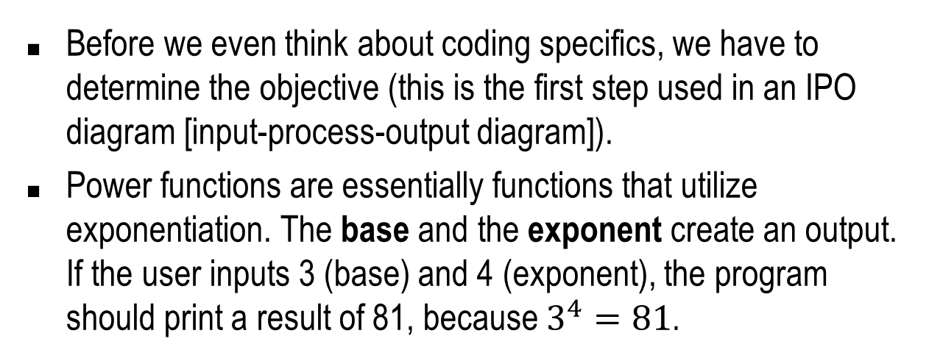
Analysis – what is known and given?
Before we even think about coding specifics, we have to determine the objective (this is the first step used in an IPO diagram [input-process-output diagram]).
Power functions are essentially functions that utilize exponentiation. The base and the exponent create an output. If the user inputs 3 (base) and 4 (exponent), the program should print a result of 81, because $3^{4}=81$.

Slide 5
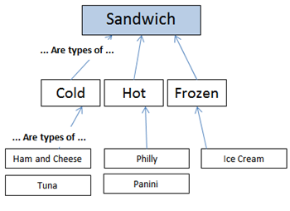
Example
The image demonstrates a polymorphism (one class, multiple methods) to OOP.

Slide 6
Analysis cont.
The compiler can calculate a value based on a base and exponent using the pow(a,b) method. Therefore, we have to import the Math and Scanner classes.
The program must run under a for loop, which means that it will repeat under certain condition or parameters. Before we declare the for loop, we must declare a loop control variable. Inside the parameters for the for loop, we have to make sure the variable will begin at 5% (.05) and end at 8% (.08) because that is the domain of our interest rates. It will increment by 1/8 (.125)

Slide 7
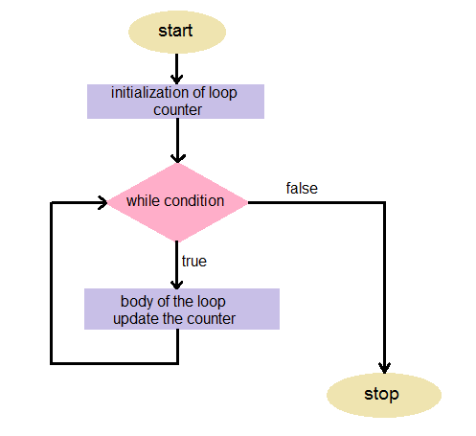
Example
Visualization of the for loop.

Slide 8
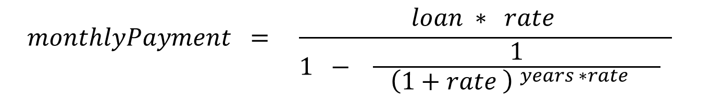
Example
We need to use problem decomposition to program this large equation for simplicity and readability. For example, the denominator can be broken up into two variables.

Slide 9
Algorithm
Create the package, import the Scanner and Math class respectively and create the main class.
Declare and initialize the necessary Scanner object to allow user input.
Declare three variables: loanAmount, loanPeriod and loopcount.
Declare and give arguments to returnPowFuncValue(loanAmount, loanPeriod, input)
End the main program.

Slide 10
Algorithm cont.
Begin a new method named returnPowFuncValue(int loanAmount, int loanPeriod, Scanner input)
Declare a for loop with a new variable called interestRate and give it the parameters of equal to .05, less than or equal to .08 and incrementing by 0.125.
Print “Enter the loan period in years.” and store the user input into loanPeriod.

Slide 11
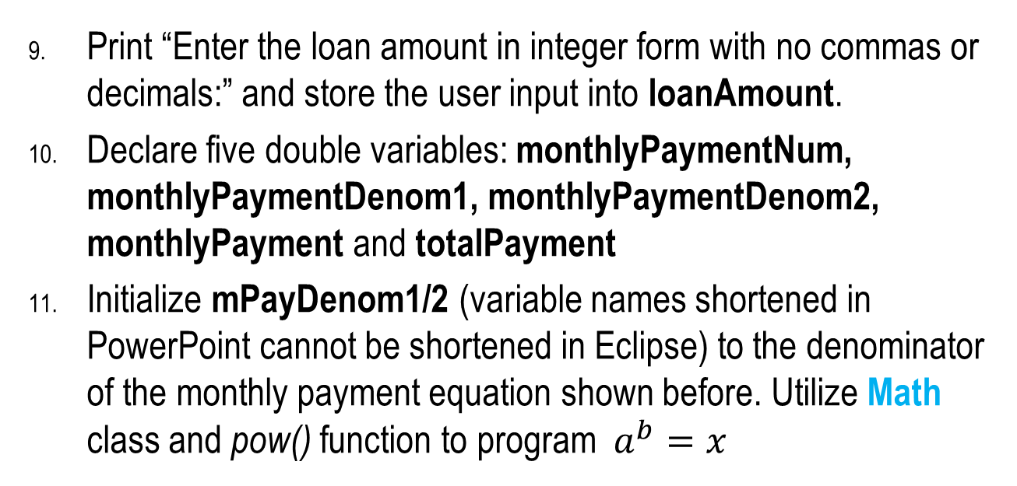
Algorithm cont.
Print “Enter the loan amount in integer form with no commas or decimals:” and store the user input into loanAmount.
Declare five double variables: monthlyPaymentNum, monthlyPaymentDenom1, monthlyPaymentDenom2, monthlyPayment and totalPayment
Initialize mPayDenom1/2 (variable names shortened in PowerPoint cannot be shortened in Eclipse) to the denominator of the monthly payment equation shown before. Utilize Math class and pow() function to program $a^{b}=x$

Slide 12
Algorithm cont.
Initialize the numerator of the mPayNum to the loanAmount times the interestRate.
Initialize the monthlyPayment and totalPayment variables to the new variables created before for brevity. For example, monthlyPayment will be equal to mPayNum / mPayDenom2.
Print a header that will display “Interest Rate”, “Monthly Payment” and “Total Payment” and their respective variables.
End the for loop, return a value of 0 to the returnPowFuncValue program and end the class

